Slide 1


Pico-Second Pulse Electron Irradiation Damage Studies in Crystalline Silicon Solar Cells
Neutron Physics and Radiation Materials
Yerevan, 27-30 october 2025
Avetiq Navoyan
Aram Sahakyan, Vachagan Harutyunyan, Arpine Martirosyan, Norair Martirosyan, Ashot Vardanyan, Eduard Aleksanyan
Email: av.navoyan@gmail.com

Slide 2
Introduction
Study of effects in materials and electronic equipment under the influence of ionizing radiation is of great importance for the creation of radiation-resistant elements and devices for space, military and other special applications.
At present, when space and Moon exploration moved to a stage of intensive development, these tasks become relevant. Spacecrafts, during the period of their existence in space, are exposed simultaneous to various factors of space.
According to modern concepts, ionizing radiation electrons with MeV energies is one of the main factors capable of damaging the electronic equipment of spacecraft.

Slide 3
Aim
Pico-Second Pulse Electron Irradiation Damage Studies in
Crystalline Silicon Solar Cells
For this purpose, the irradiations will be used electrons with an energy of up to 3.5 MeV at the CANDLE Institute for Synchrotron Research.
The nature and extent of the radiation effect on the physical parameters of materials strongly depends on the:
type and energy of irradiation particles
irradiation intensity
irradiation conditions

Slide 4
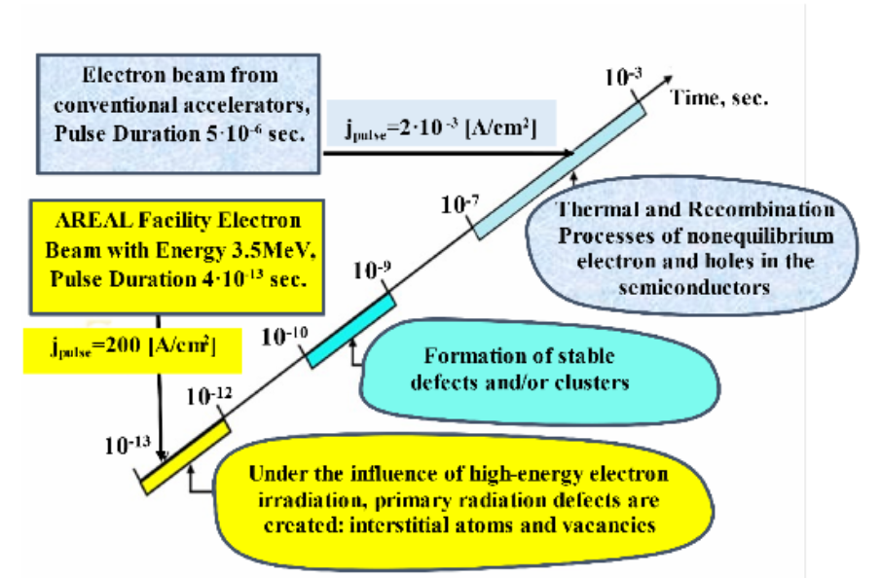
Fig. 1. Schematic presentation of the processes occurring in a semiconductor crystal after the irradiation by high-energy electrons.

Slide 5
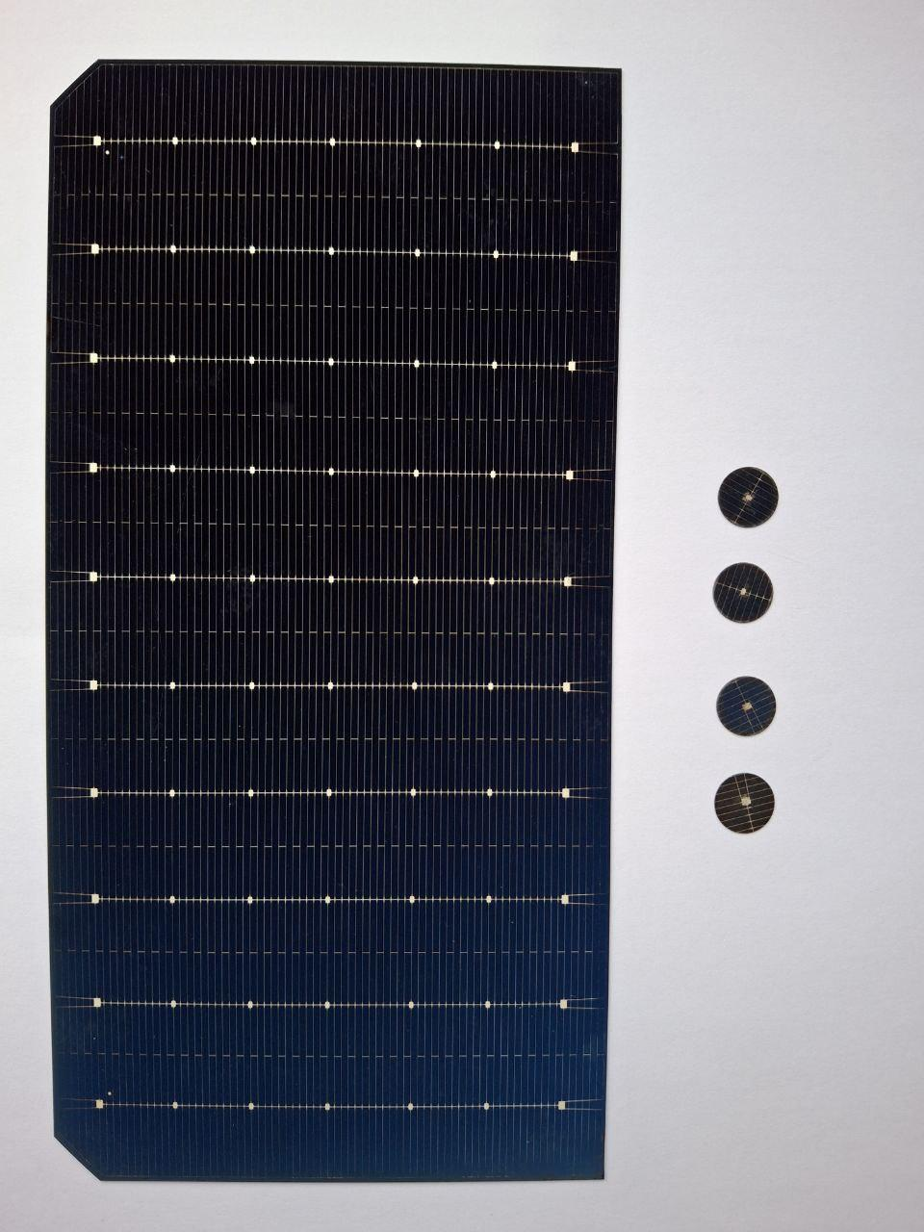
The crystalline silicon solar cells were manufactured using the latest PERC (Passivated Emitter and Rear Contact) technology, and provided by LA-Solar organization.
The solar cell samples were obtained from a commercial crystalline silicon solar panel by laser cutting, resulting in round disks with a diameter of 10 mm and a thickness of 0.2 mm. The sample size was selected to ensure uniform irradiation, as the electron beam cross-section has a diameter of approximately 16 mm. The thickness of p-Si is about 200 µm, and n + -Si is 1 µm.
The solar cell parameters were measured using the Sol-UV Ultraviolet Solar Simulator device (CLASS AAA MODEL:94023A, Newport Calibration Cert.#2760).
Fig.3. General view of the solar cell samples

Slide 6
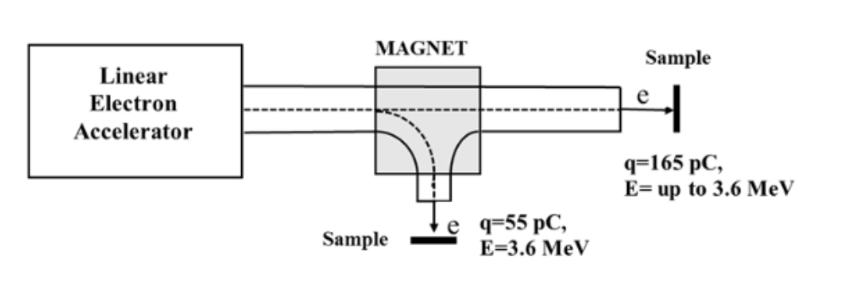
Fig.2. Block diagram of linear electron accelerator and samples mounting. When the magnetic field is
turned on, the electron pulse charge is 55 pico-Coulomb with energy 3.6 MeV and when the magnetic
field is turned off in the direct beam the electron pulse charge is 165 pico-Coulomb with
energy up to 3.6 MeV.

Slide 7
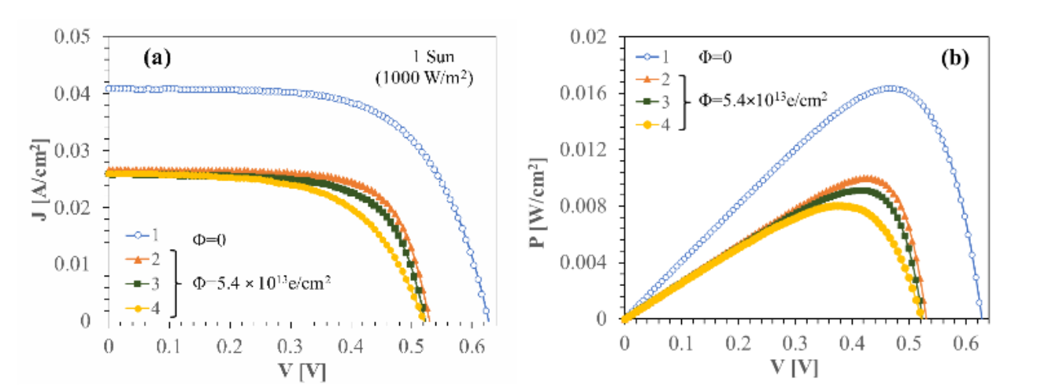
Fig.4. Illumination J-V and P-V characteristics of solar cell samples before and after electron irradiation
with fluence of 5.4 × 10¹³ e/cm² . Three samples were irradiated under similar conditions to ensure
statistical reliability.

Slide 8
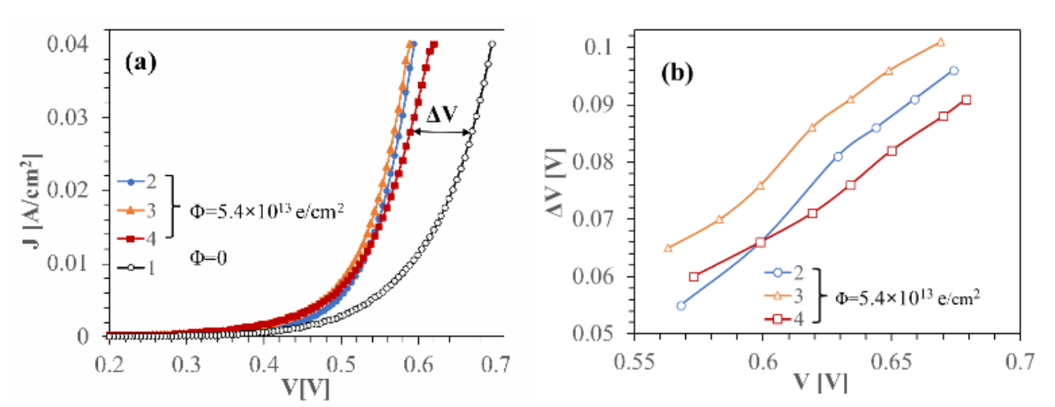
Fig.4. Forward J-V dark characteristics of solar cell samples (1) before and (2,3,4) after electron
radiation, using a fluence of 5.4 × 10¹³ e/cm² (a). Dependence of ∆V shift of irradiated samples J-V dark
characteristics on the applied bias voltage (b).

Slide 9
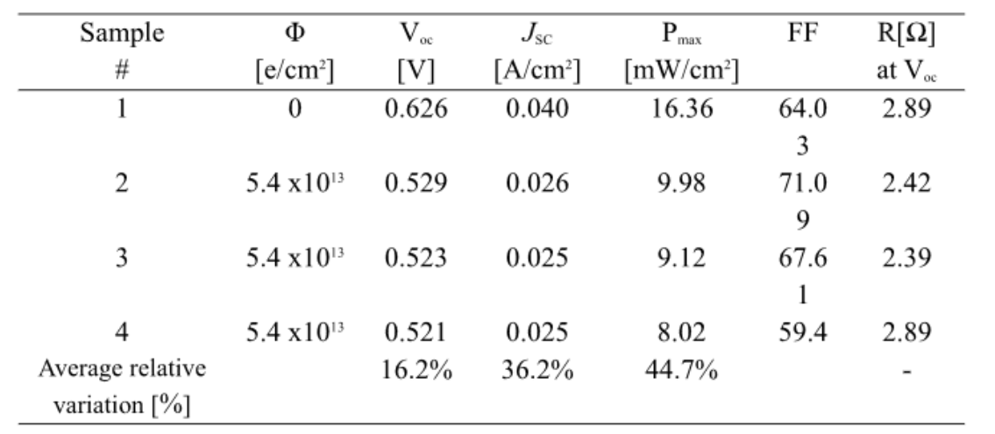
Table 1. Solar cell parameters before (1) and after irradiation (2, 3, 4) using electrons with an energy of up to 3.6 MeV and a fluence of 5.4 × 10¹³ e/cm² measured under an illumination of 1 Sun (1000 W/m² ).

Slide 10
Conclusions
We have presented the results of a study of the influence of irradiation using an ultrashort, pico-second (τ = 4 × 10⁻¹³ s) pulse electron beam, containing electrons with energies up to 3.6 MeV, current density in the pulse j pulse = 200 A/cm² and a fluence of 5.4 × 10¹³ e/cm² , on the parameters of commercial crystalline silicon solar cells fabricated by PERC technology. Under these conditions, stable radiation defects are formed in the crystal much earlier than the timescale over which thermal and recombination processes occur.
Despite the relatively low electron irradiation energy, the induced radiation defects are mainly of the cluster type. This is probably due to the dominant role of the high electron beam intensity in the defect formation process. As compared with literature data for irradiation with 1 MeV electrons, more than 40% reduction in the maximum power for silicon solar cells is found to occur at a fluence lower by more than two orders of magnitude, when ultra-short electron pulses are used.

Slide 11
The article “Pico-Second Pulse Electron Irradiation damage studies in crystalline silicon solar cells” has been accepted for publication by journal “Solar Energy Materials and Solar Cells”.
Authors: Aram Sahakyan, Vachagan Harutyunyan, Norik Grigoryan, Arpine Martirosyan, Norair Martirosyan, Ashot Vardanyan, Christopher Rhodes, Eduard Aleksanyan
Journal: Solar Energy Materials and Solar Cells (Q1, IF 6.3) 265 (2026) 113956,
https://doi.org/10.1016/j.solmat.2025.113956

Slide 12
Thank you

